Slide 1

Unit 1:- Electric and Hybrid Powertrain Technologies
By:- Dr. Chetan Khadse

Slide 2
Syllabus…Unit 1 Focus On….
Lecture | Topics to be covered
L1 | Introduction to vehicles, IC engine & Battery Electric Vehicles (BEV’s) , history and social importance
L2 | Benefits of E vehicles, Types of E-vehicles on the basis of propulsion devices, Energy sources and energy carriers.
L3 | PEV’s & HEV’s , BEV, HEV, FCEV, UCEV and UFEV
L4 | Classification of HEV, Micro hybrid, mild hybrid, full hybrid, plug-in hybrid and range extended hybrid electric vehicle.
L5 | Parallel hybrid, Series Hybrid, Power split and compound Hybrid Configuration Plug-in Hybrid Electric Vehicles (PHEV’s),
L6 | Hybrid Hydraulic vehicles (HHV),Pneumatic Hybrid Vehicles, (PHVs)
L7 | Power/Energy Management System

Slide 3
Lecture 5
Challenges of BEV
Challenges of Conventional HEV’s
Challenges of Grid able HEV’s
Challenges of Fuel Cell EV’s
Challenges of UCV & UFV
Components of an EV
Transmission Configurations EV
Front & Rear Wheel Drivetrain
Dual & Four Wheel Drivetrain
Architecture of EV
Hybrid Drive train
Classification as per Drive Train
Series Hybrid
Series Hybrid Operation Modes

Slide 4
Challenges of BEV ….
  Limited Driving Range
The energy storage capacity of a battery electric vehicle is lower compared to a IC engine based vehicle because of low specific energy and low energy density of battery compared to a liquid fuel. Therefore, it offers a limited
For similar conditions, BEV gives 120 kilometers per charge ICE gives 500 kilometers per charge
High Initial cost
More battery banks are used to match the operation of IC engine
It is not only oversized, it is very costly
The battery have a limited cycle life of around 1500 which means four to five years, it requires replacement of battery bank

Slide 5
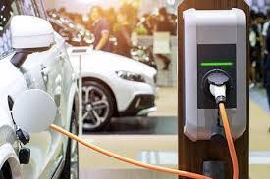
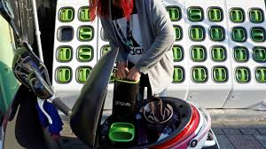
Challenges of BEV ….
Lack of charging infrastructure
Normal charging: 5 to 8 hrs., 110-120V, 13 to 40 Amp, 2 to 4 KW
Fast charging: 30 min to 1 hour, 200 to 400 Volt, 100-200 Amps and 50 kilowatt
Battery swapping station
Cost Charging infrastructure
Effect on the power grid
These systems put a lot of pressure on the power grid since it is drawing very high currents from the utility grid and it requires a costly charging infrastructure.

Slide 6
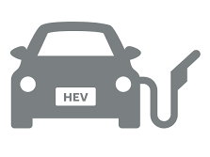
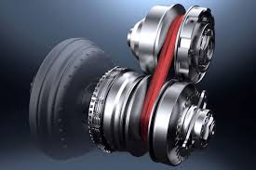
Challenges of Conventional HEV’s….
Non-zero emissions
Low energy diversification that it can be only refueled using oil and natural gas.
Complex Systems and lot of coordination
Variable Transmission system
  Has its own losses
  It creates a lot of noise
  It requires regular lubrication
System is quite heavy and also bulky

Slide 7
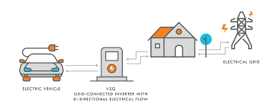
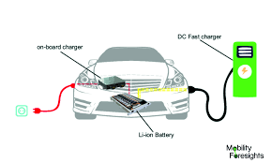
Challenges of Grid able HEV’s….
All challenges of conventional HEV
  Non-zero emissions
  Low energy diversification
  Variable Transmission system
  Heavy and Bulky
Installation of Onboard charges
More Initial cost
  It is more costly since it requires more battery capacity

Slide 8
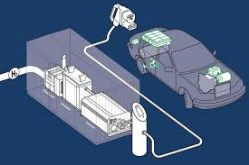
Challenges of Fuel Cell EV’s….
More Initial cost
  Cost of Fuel cell
Lack Of Hydrogen Refueling Infrastructure
The Storage Of Hydrogen
  Compressed Hydrogen Gas
Similar to CNG, hydrogen gas can be compressed
Liquid Hydrogen : It requires technology similar to cryogenic storage technology which is also costly.
Metal Hydrides: It can also be stored in a solid form as metal hydrides, very similar to battery swapping.
It has high safety concerns of explosion and lots of safety factors to be in place before it can be commercially viable

Slide 9
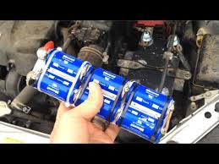
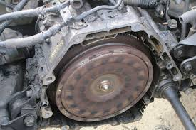
Challenges of UCV & UFV ….
More Initial cost
  Cost of UCV & UFV is high.
Low Specific Energy
It cannot be used as a sole energy source
and it requires battery as a hybrid energy source along with it.
UFV has a extra safety concern
Ultra-flywheel which stores mechanical energy at high speed of flywheels often have safety concerns and is less reliable.

Slide 10
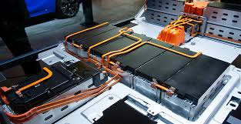
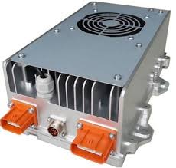
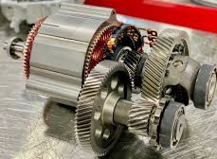
Components of an EV ….
• Battery
It powers the electric motor. Its capacity is defined in Ah. The design of battery includes complex calculations which determines various battery parameters
• Power convertor
The electrical energy stored in battery is fixed DC which should be converted to either variable DC or Variable AC which depends on the type of electric motor used for power the wheels
• Electric Motor
DC series, Induction motors were used at the earlier stage. Now the scope has shifted towards special electrical machines

Slide 11
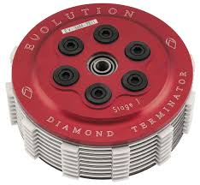
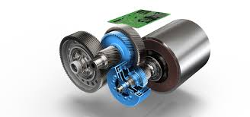
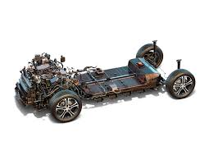
Components of an EV ….
Clutch
The engine must be decoupled from the wheels to shift from low speed to high speed gears or vice versa, this is done by the clutch.
• Transmission
The gearbox is also called as transmission
which allows transfer of power from engine to wheels.
• Drivetrain
The combination of Electric motor, Clutch, Gearbox is referred to as drivetrain

Slide 12
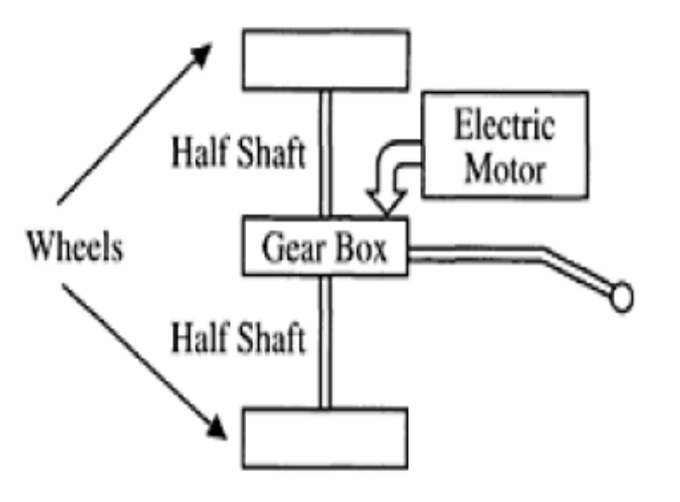
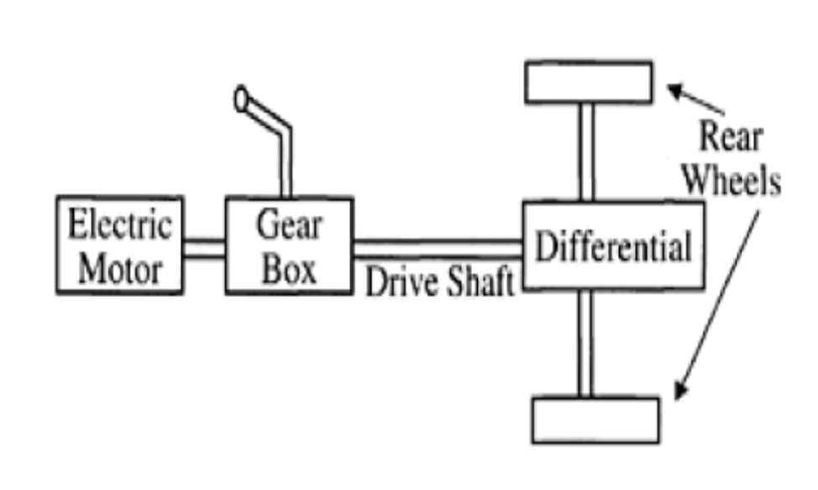
Transmission Configurations EV….
Front-wheel Drive
Rear-wheel Drive
Single Propulsion Motor: The single motor drives the transaxle on a common axis, delivering power to the two wheels differentially through a hollow motor shaft

Slide 13
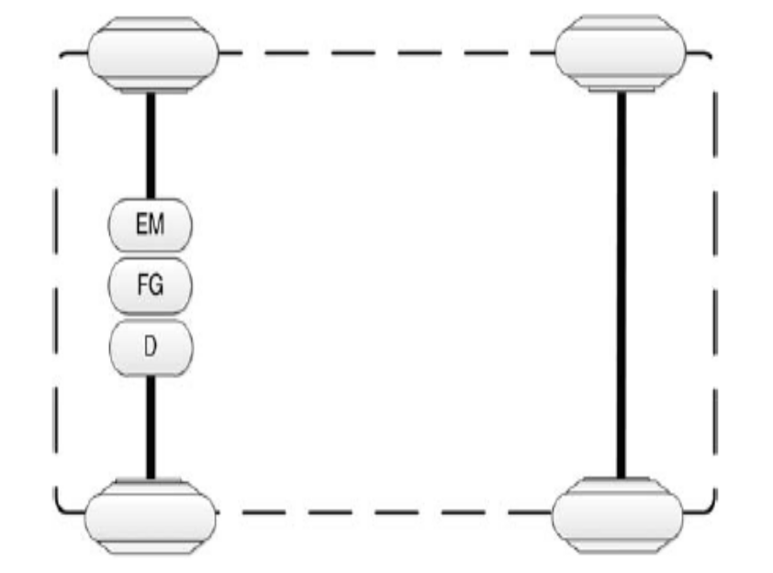
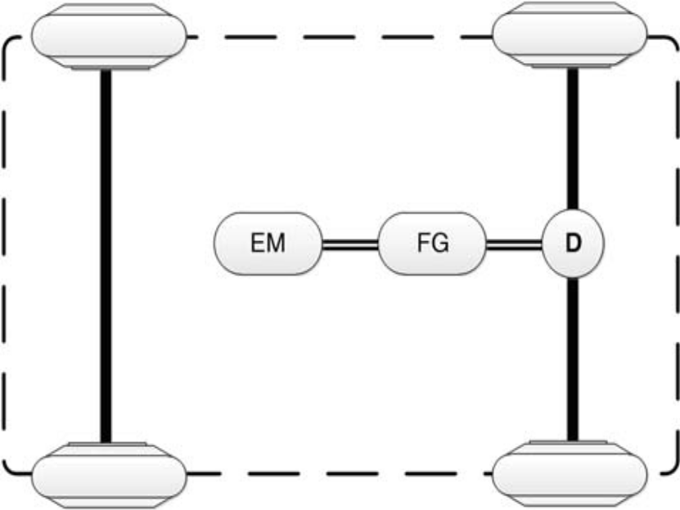
Front & Rear Wheel Drivetrain….
Front- out wheel Drive
Rear- out wheel Drive
EM Electric Motor
FG: Fixed Gear
D: Differential Gear

Slide 14
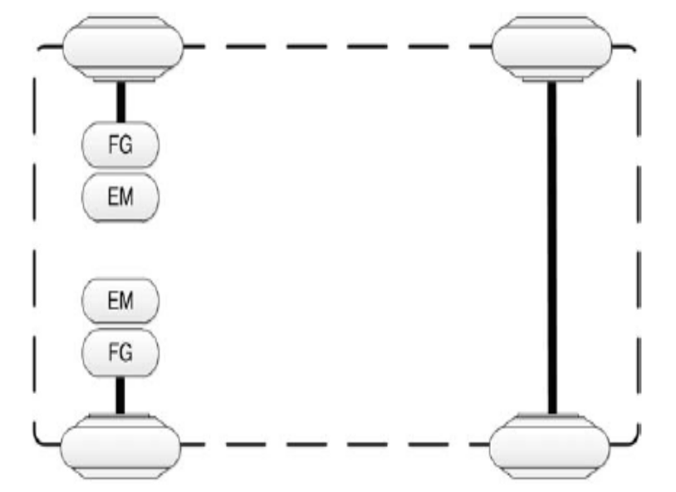
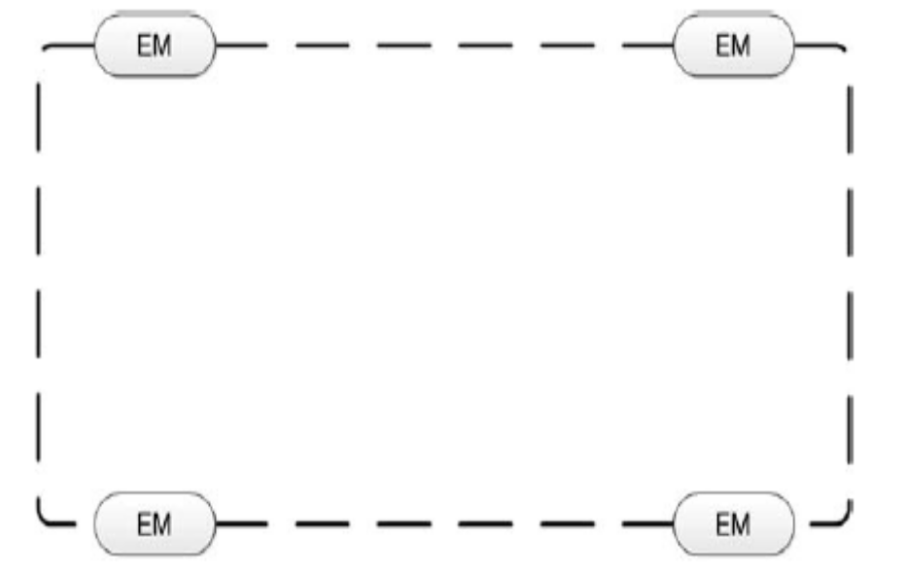
Dual & Four Wheel Drivetrain ….
Front- out wheel Dual Drive
In wheel / Four Wheel Drive
EM Electric Motor
FG: Fixed Gear
D: Differential Gear

Slide 15
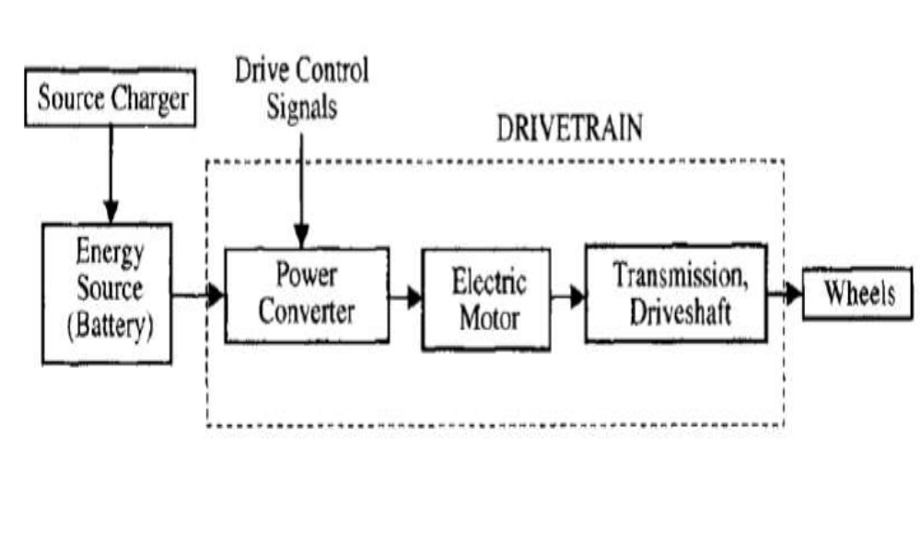
Architecture of EV….

Slide 16
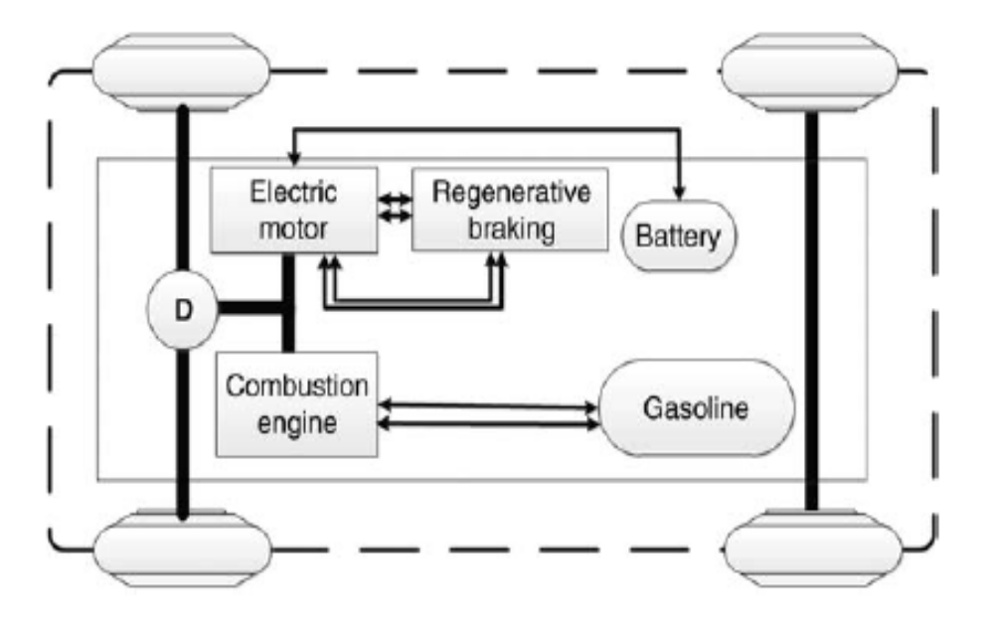
Hybrid Drivetrain of EV….

Slide 17
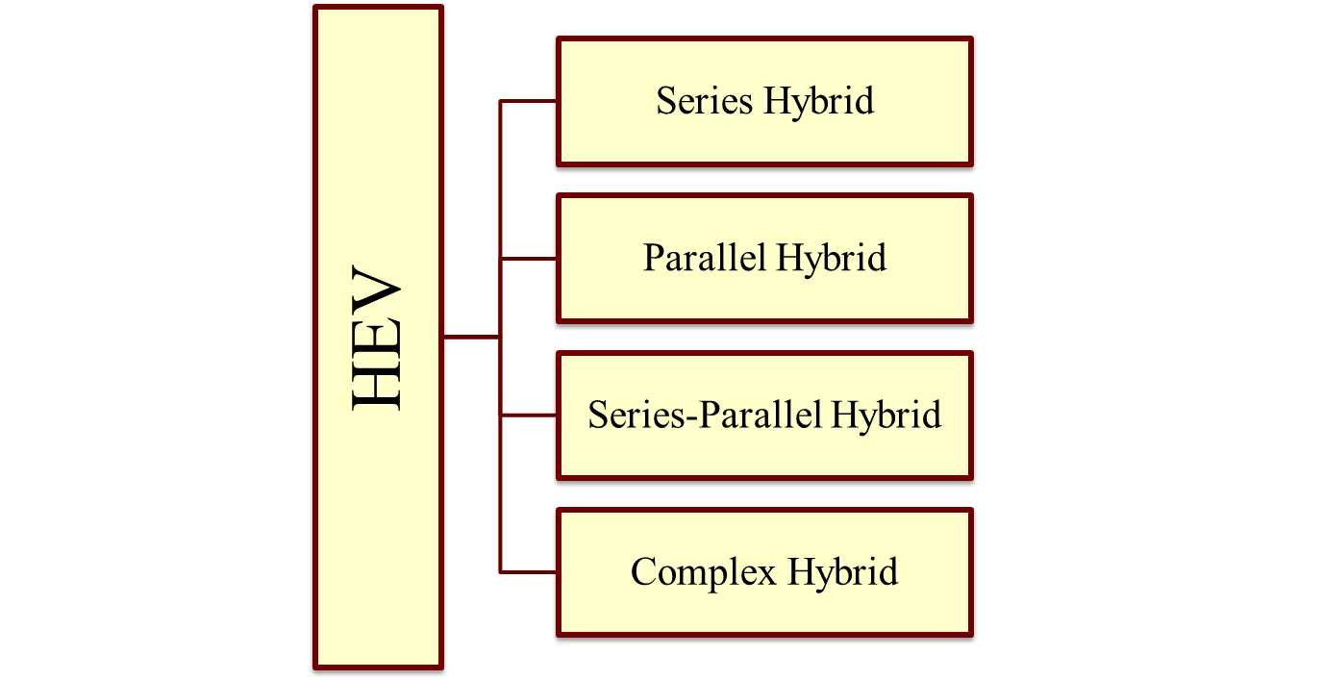
Classification as per Drive Train ….

Slide 18
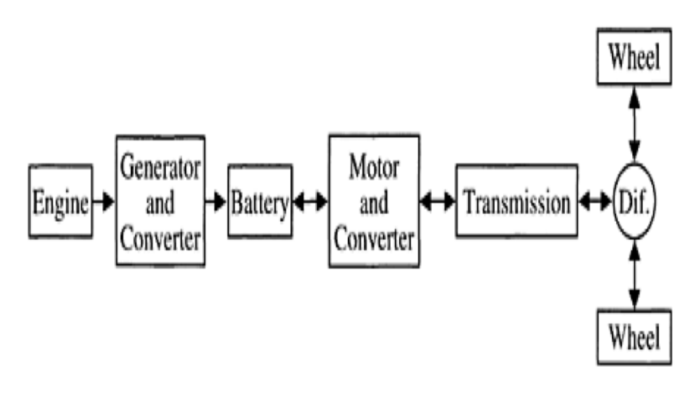
Series Hybrid ….

Slide 19
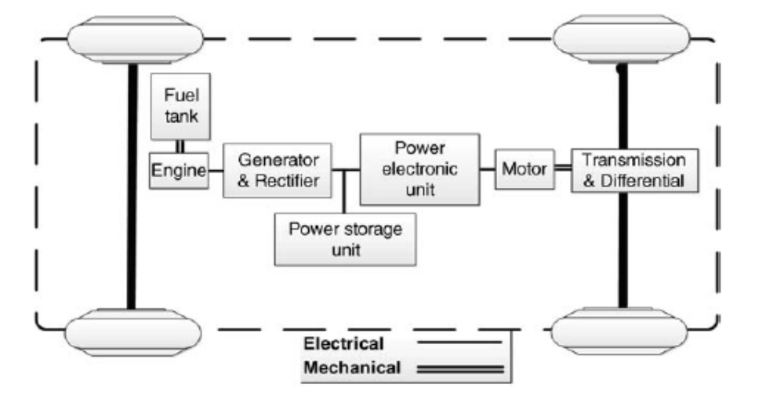
Series Hybrid ….

Slide 20
Series Hybrid Operation Modes….
Engine-alone traction mode: In this mode, the combustion engine only provides the total required power for vehicle motion through the generator while the electric motor acts as an electric transmission between the engine and the driving wheels. The batteries neither provide nor receive any power from the drivetrain.
Electric-alone traction mode: In this mode, the engine is off and the electric source supplies the total required power for vehicle motion.
Hybrid mode: In this mode, the engine–generator and batteries simultaneously deliver traction power to the wheels.

Slide 21
Series Hybrid Operation Modes….
Engine traction and battery charging mode: In this mode of operation, the engine–generator provides the traction power while charging the batteries.
Regeneration mode: The regenerative braking system charges the batteries during braking, decelerating, and downhill travel. In this mode, the traction motor operates as a generator and the engine-generator is not active.
Battery-charging mode: In this mode, the traction motor stops while the batteries are charged by the engine–generator.
Hybrid battery-charging mode: Both the engine–generator and traction motor operate as a generator and charge the batteries simultaneously.

